Slide 1
PI: Patrice Bouyer
Project: Engaging Community College Student in research: Intestinal host defense mechanism

Slide 2
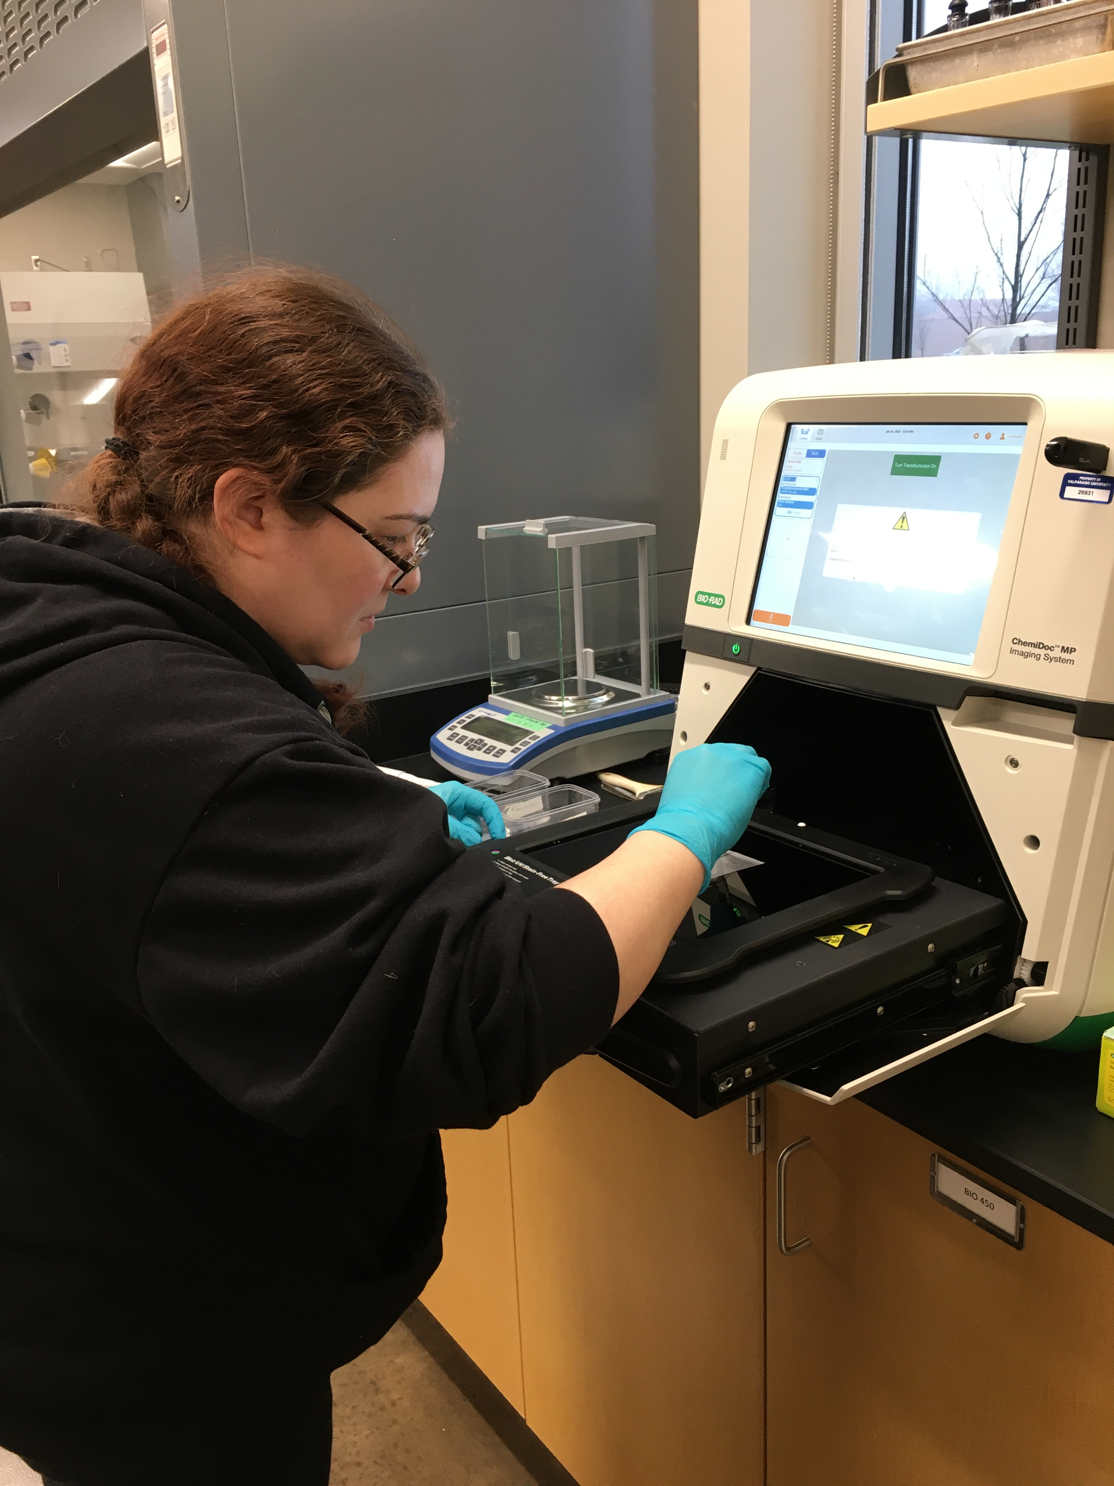
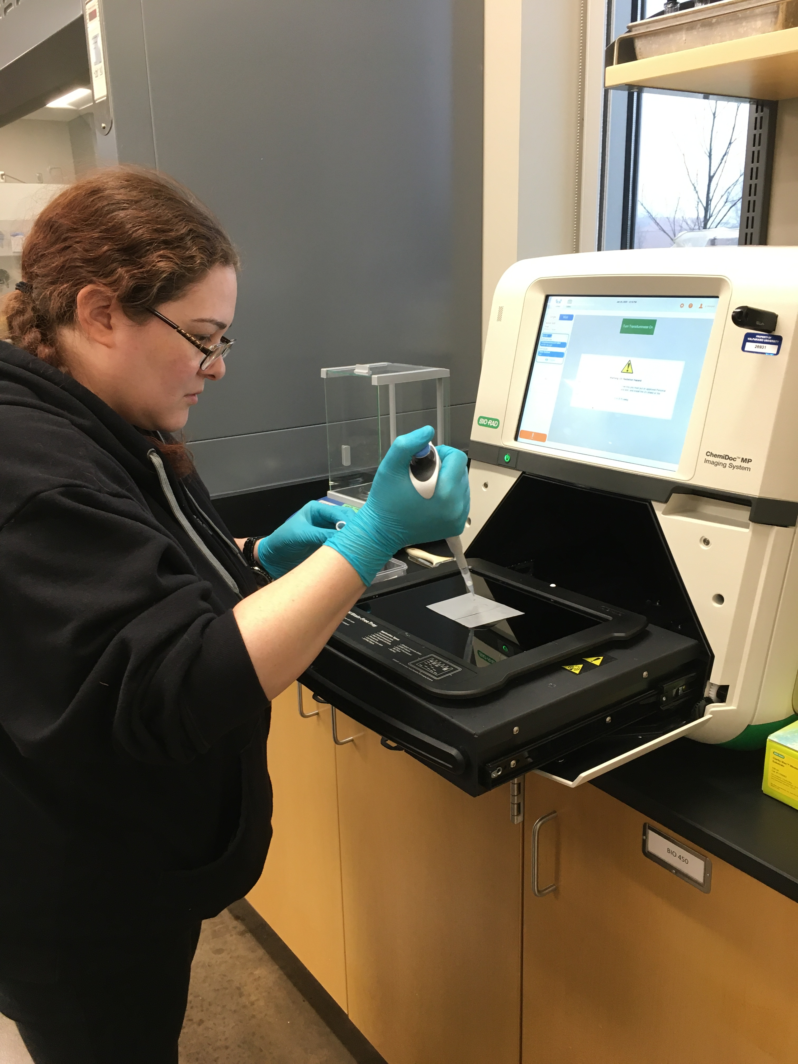
Notes:
Amanda Bazaldua (community college student) preparing a PVDF membrane to be processed by the cChemidoc to detect the presence of the protein NKCC1 by chemiluminescence

Slide 3
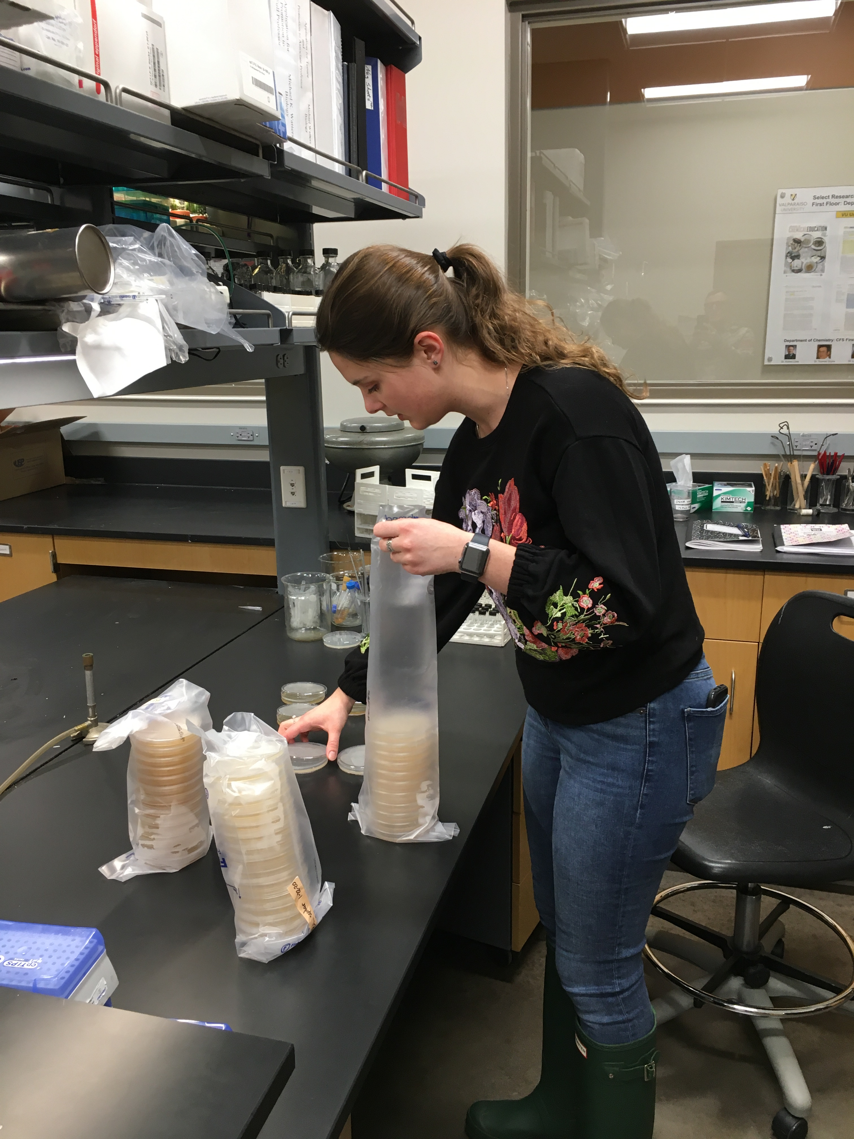
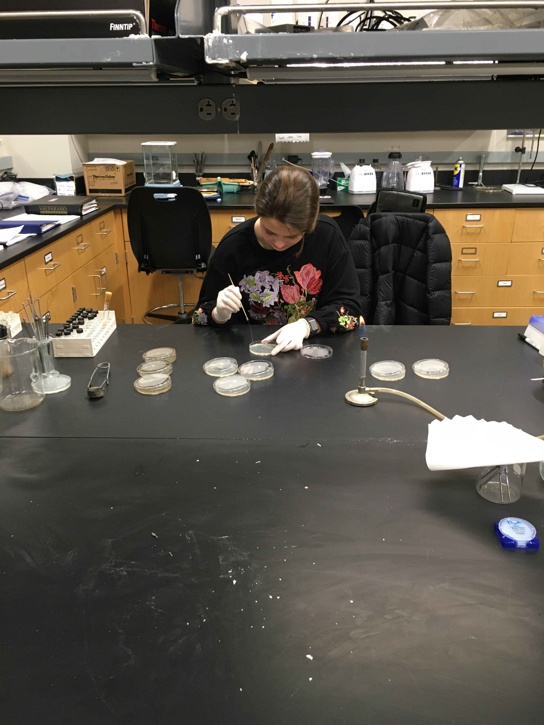
Notes:
Idalia Zachara (Valpo student) preparing agar plates for inoculation (left photo). On the right, she is inoculating plates to study C. albicans morphology later on

Slide 4
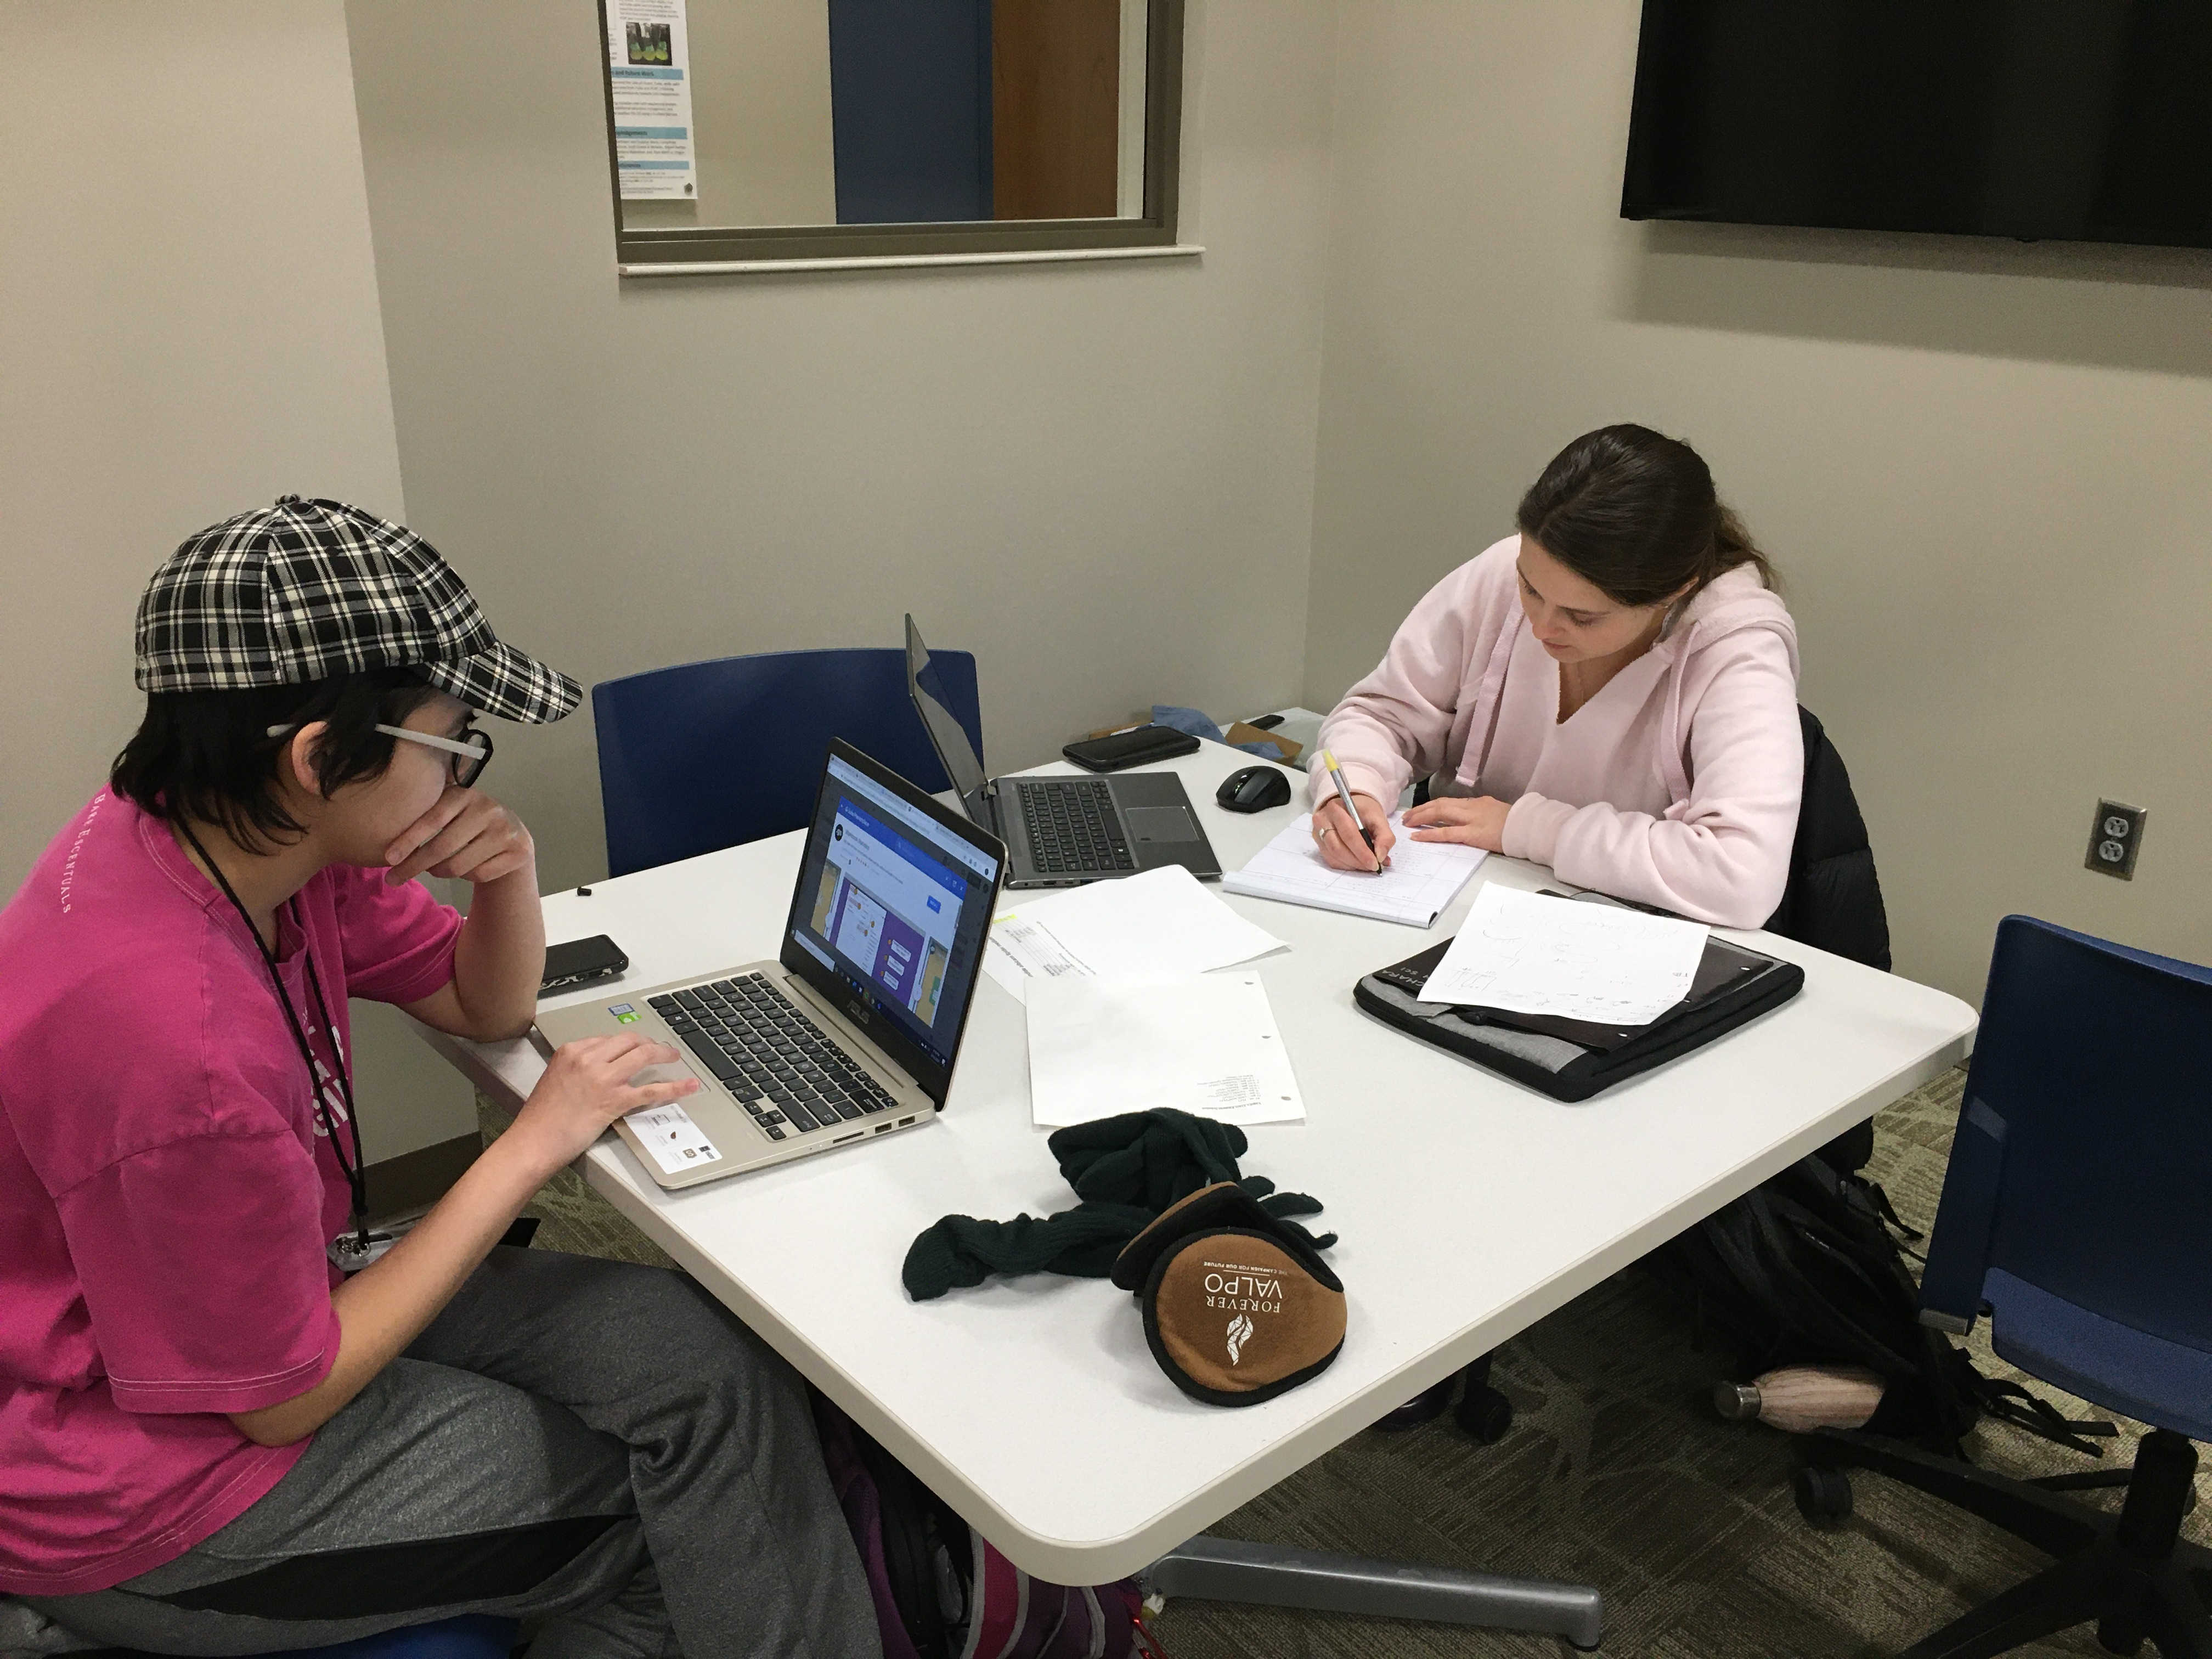
Notes:
On the left, Paige Camp (Valpo student) and on the right Idalia Zachara (Valpo student) analyzing C albicans morphology data and working on the protocol for the next set of experiments

